Slide 1
Neural Networks
(the fully connected kind)
Why the big deal?
A.k.a. why are they so powerful?

Slide 2
Agenda
BMI
Example
Fully-connected Neural Network Anatomy
Input layer
Hidden layer
Output layer
Slight detour
Limitations
Example of when we want to use (convolutional) Neural Networks

Slide 3
What is Body Mass Index (BMI)?
Literally:
What is it a proxy for?
From the high-level perspective of modeling / machine learning?
What is it called when you combine two variables in a novel way?
Notes:
A transformation

Slide 4
What is Body Mass Index (BMI)? (answers)
Specifically: mass / height²
Proxy for: obesity
More generally, it’s an example of a:
Transformation.

Slide 5
Question/Challenge
Can a Neural Network calculate BMI?
[switch to code]

Slide 6
Question/Challenge
Can a Neural Network calculate BMI?
(to a high degree)
YES!
I would argue this is a big deal. Before I get to that, let’s talk about what’s happening happens in a neural network.

Slide 7
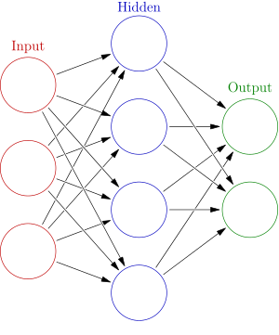
Anatomy of a fully connected neural network
It is composed of
An input layer,
A number of hidden layers, and
An output layer
A N-layer neural network has N-1 hidden layers.
The image to the left is a 2-layer NN (the input layer is not counted).
The “1st layer” is the first non-input layer.
The lines between represent activations—number values in the Real Numbers (-∞,∞)

Slide 8
Input Layer Anatomy
The input layer is analogous to the input dataset (for one observation). That is, there will be as many nodes as there are variables. This example has three input variables (intercept not pictured).
The values of X (often indexed as the zero-th activation) are passed to the first hidden layer.

Slide 9
Hidden Layer Anatomy—there can be several
The number of nodes in a hidden layer(s) is a hyperparameter, i.e. arbitrarily chosen to maximize performance.
Within each node within a hidden layer two things occur (in order):
Linear regression using the input activation
Output from that regression passes through an activation function.
The output (the new activation) from this is then passed as the next layer’s input activation.
Each node has different parameters, but uses the same input activations within a given layer.

Slide 10
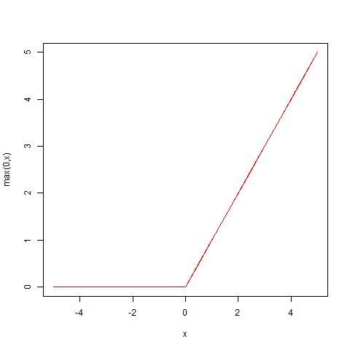
Hidden Layer Anatomy, continued
The most common activation function is the rectified linear unit (RELU):
RELU(x) =
Max(0,x)

Slide 11
Output Layer
The number of nodes in the output layer is determined by the number of outputs. This one has two.
There is a final regression. The outputs of these regressions are often manipulated into predictions, and are compared to the actual output, i.e. the Y’s.
(topic for a future presentation…)

Slide 12
Why on earth would we ever use neural networks?
Why, again, is it a big deal that neural networks can calculate BMI?
“We’re capable of calculating it ourselves.”
Who here is familiar with the concept of Peer Review?
BMI was originally proposed in the early 19th century.
You need only search PubMed to see that BMI has been through that wringer, and there are still people arguing over the validity of BMI.

Slide 13
Why are we talking about Peer Review?
Well, for those of you familiar, peer review can be a tedious, time-consuming endeavor.
Suppose you were to propose an novel/alternative transformation to create a proxy for obesity.
You would have to go through the peer review process all over again.

Slide 14
Why are we talking about Peer Review?
We fed the neural network a bunch of noise, and it was still able to see through all of that noise to replicate a meaningful transformation…
One (should) say:
“But John, this is a deterministic outcome.”
And that’s correct—we can simply calculate it ourselves.
Can someone give me an example of a model that might use BMI?
Notes:
Let’s abandon determinism

Slide 15
Why are we talking about Peer Review?
Our previous neural network had an input layer of 6, and two sequential hidden layers of size 16. This was sufficient to predict BMI.
Suppose instead, we added on another hidden layer, the other 4 variables were patient information (e.g. blood sugar, insulin resistance, lipids, etc.), and tried to predict the likelihood of a patient developing type 2 diabetes.

Slide 16
Why are we talking about Peer Review?
We know our NN is capable of simulating BMI by that point. This complex architecture enables neural networks to find meaningful, highly-predictive, complex transformations--skipping peer review entirely.
This is why Neural Nets are a big deal.

Slide 17
Follow-up Questions
Are the final parameter values or transformations interpretable?
Almost uniformly no--black box
Do neural networks provide measures of uncertainty (p-values, confidence intervals, standard errors, etc.)?
No.--black box
Can we perform inference using the parameter estimates in the final neural network?
Nope--black box
Are Neural Networks highly predictive?
Yes!... But they’re a black box.

Slide 18
When would we want to use Neural Networks?
Consider the following example (beyond the scope of fully connected NN’s) of a process we wish to automate:
We are looking at millions of 64 pixel by 64 pixel color photos.
We wish to determine if there is a cat in a given photo.
Each photo will have 12288 (=64*64*3) distinct data points (3 RGB channels).

Slide 19
When would we want to use Neural Networks? (continued)
This “process” has 3 distinct characteristics that make it well suited to (convolutional) neural networks:
There is clear signal in the process (The “cat-ness” of a photo is rarely, if ever, in question),
There is a large amount of data (as in, the number of observations), and
There is a large amount of data in each observation, with no clear means of quantifying “cat-ness” from the base data.
Letting Neural Networks do the heavy lifting of identifying the necessary transformations is easier.

Slide 20
Questions?

